Slide 1
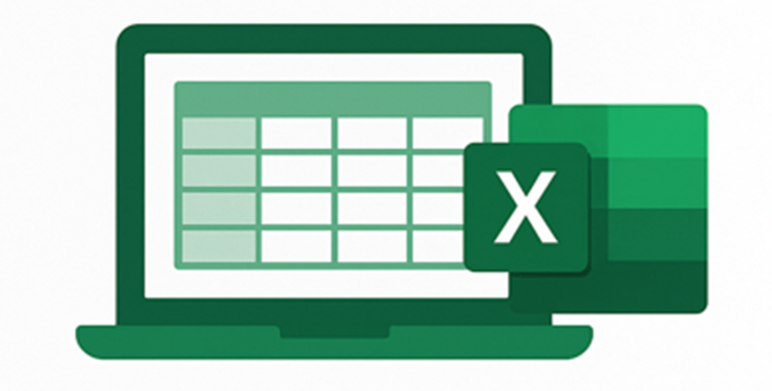



Excel
Training
for Beginners
SAID FAWZY
Manager of Information Center
Tendering Department
Arab Contractors

Slide 2


Excel
Training
for Beginners
SAID FAWZY
1
Getting Started with Excel

Slide 3






90%
90%
1- Exploring the Excel Application
2 - Understanding the Excel Start Screen
3 - Navigating the Excel Interface
4 - Working with Ribbons, Tabs, and Menus
5 - Exploring the Backstage View

Slide 4
90%
90%
6 - Customizing the Quick Access Toolbar (QAT)
7-Mastering Useful Keyboard Shortcuts
8 - Finding and Using Excel Help
Exam 1: Working with Excel

Slide 5
Excel
Training
for Beginners
SAID FAWZY
Exploring the Excel Application
1

Slide 6
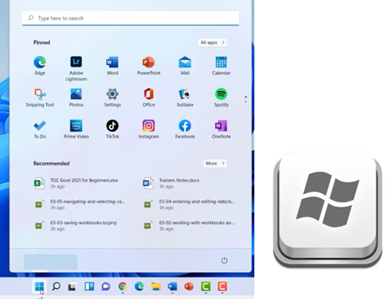
Exploring the Excel Application
Start Excel

Slide 7
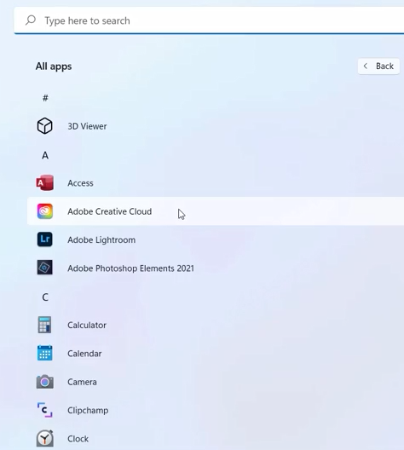
Exploring the Excel Application
Start Excel

Slide 8
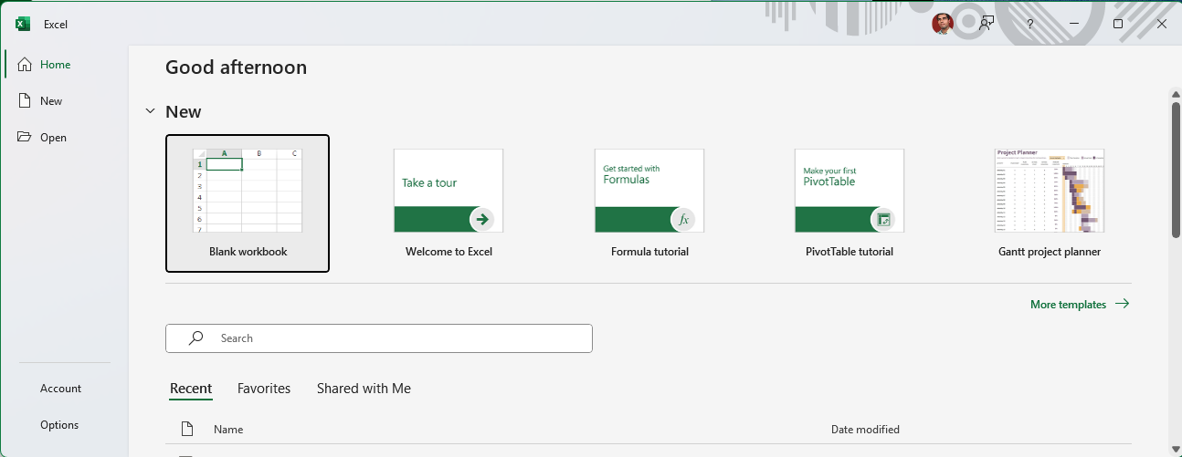
Exploring the Excel Application
Start Excel

Slide 9
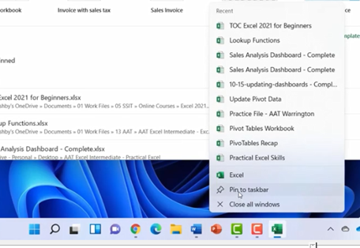
Exploring the Excel Application
Pin Excel to Task bar

Slide 10
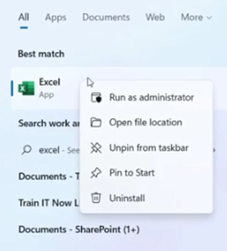
Exploring the Excel Application
Pin Excel to Start Menu

Slide 11
Excel
Training
for Beginners
SAID FAWZY
Understanding the Excel Start Screen
2

Slide 12
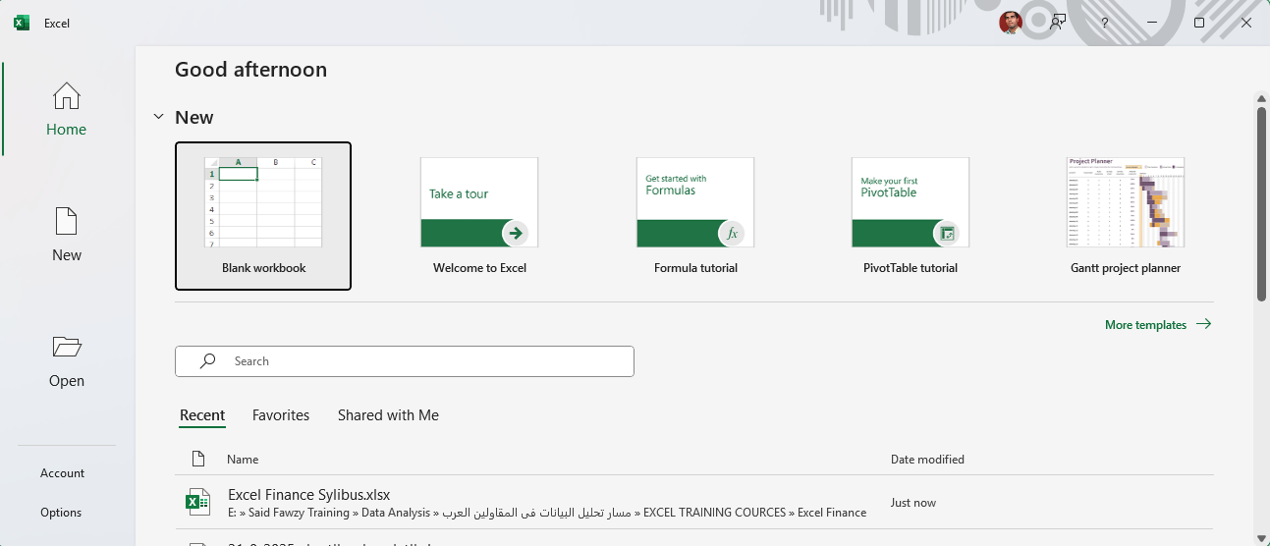
Understanding the Excel Start Screen

Slide 13
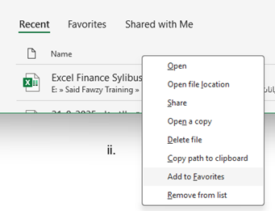
Understanding the Excel Start Screen
Home Page

Slide 14
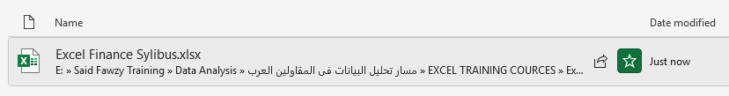
Understanding the Excel Start Screen
Home Page

Slide 15
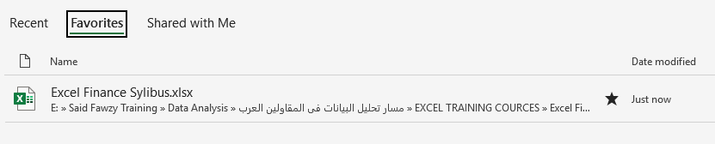
Understanding the Excel Start Screen
Home Page

Slide 16
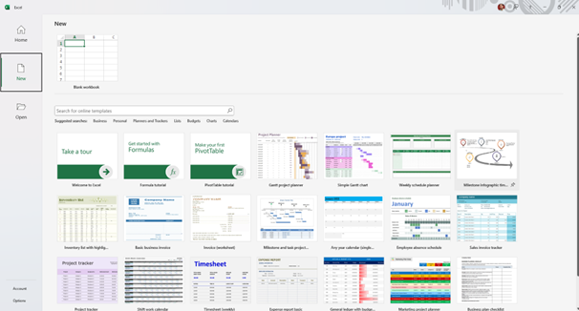
Understanding the Excel Start Screen
New Page

Slide 17
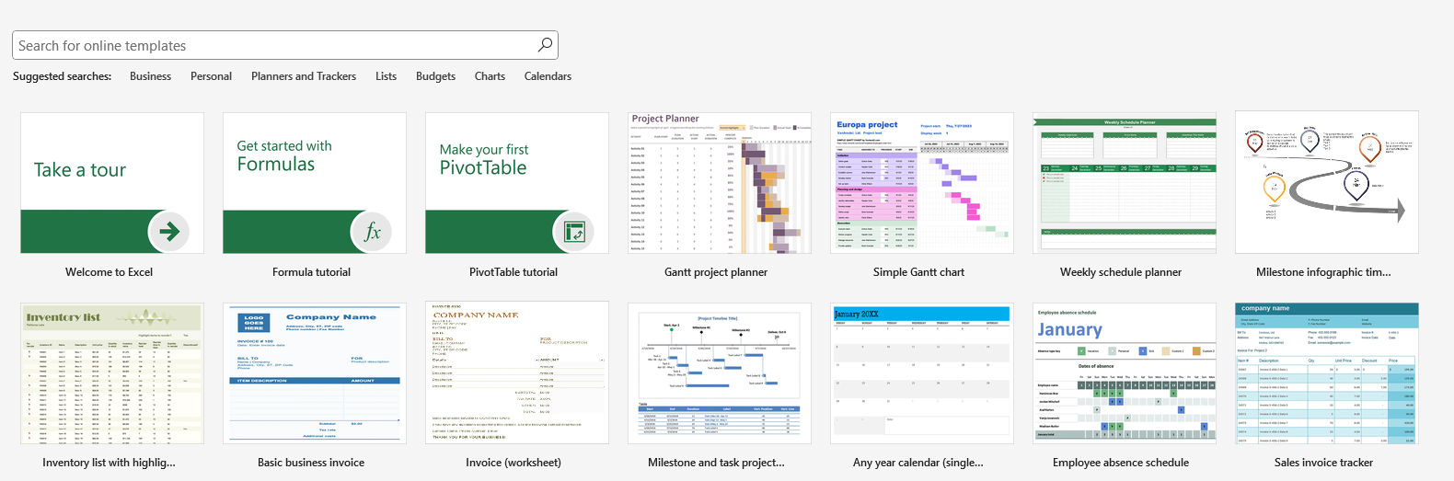
Understanding the Excel Start Screen
New Page

Slide 18
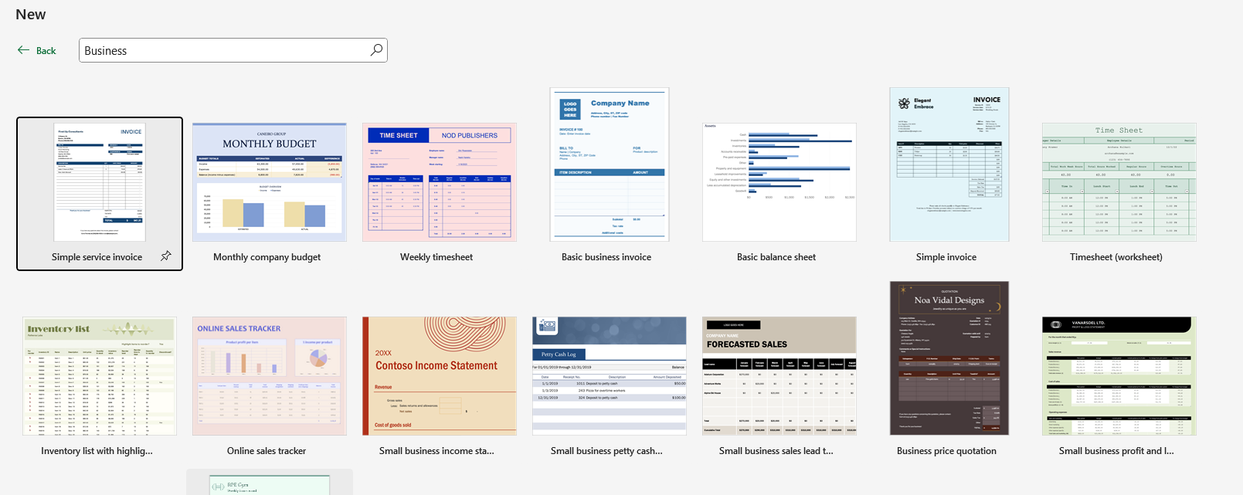
Understanding the Excel Start Screen
New Page

Slide 19
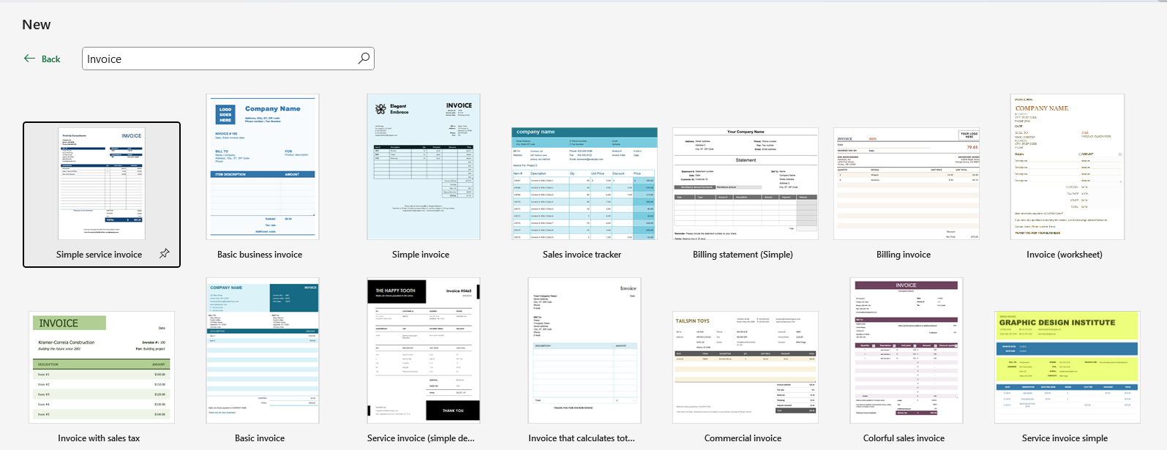
Understanding the Excel Start Screen
New Page

Slide 20
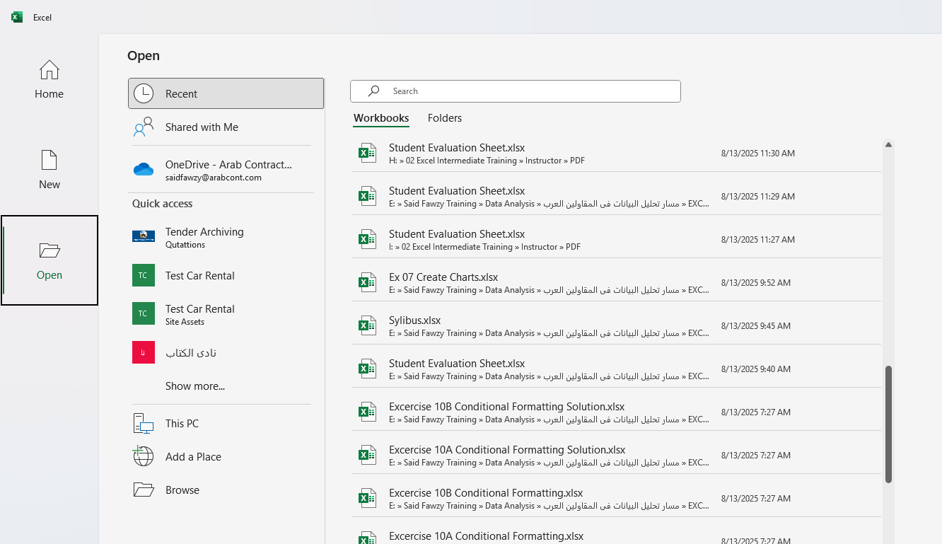
Understanding the Excel Start Screen
Open Page

Slide 21
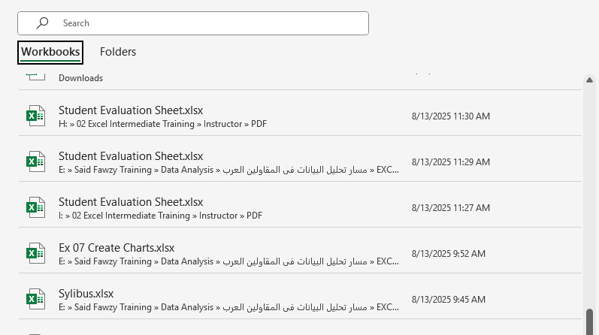
Understanding the Excel Start Screen
Open Page

Slide 22
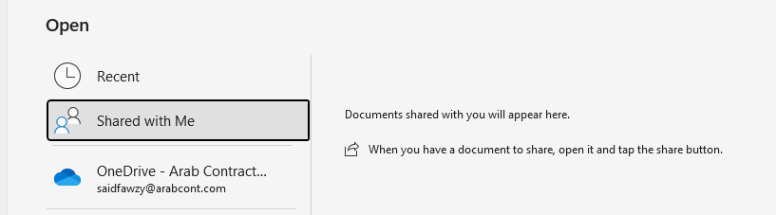
Understanding the Excel Start Screen
Open Page

Slide 23
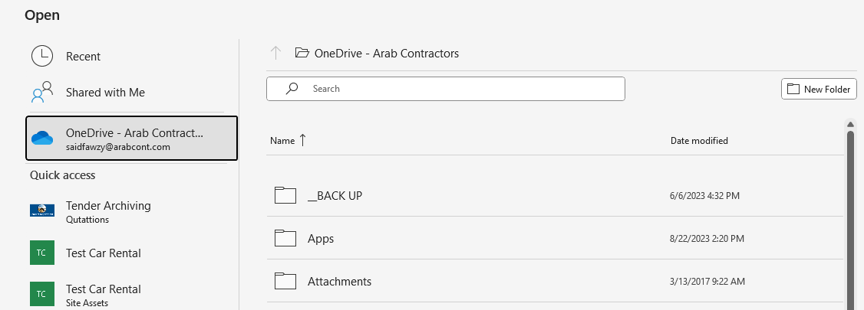
Understanding the Excel Start Screen
Open Page

Slide 24
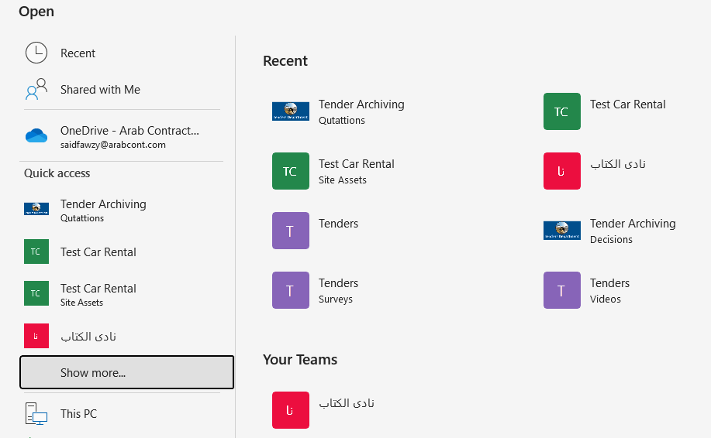
Understanding the Excel Start Screen
Open Page

Slide 25
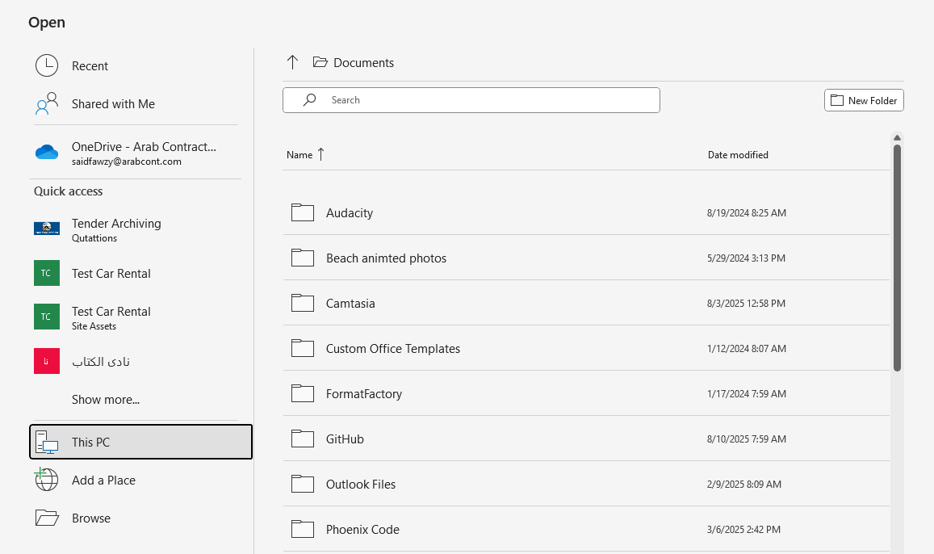
Understanding the Excel Start Screen
Open Page

Slide 26
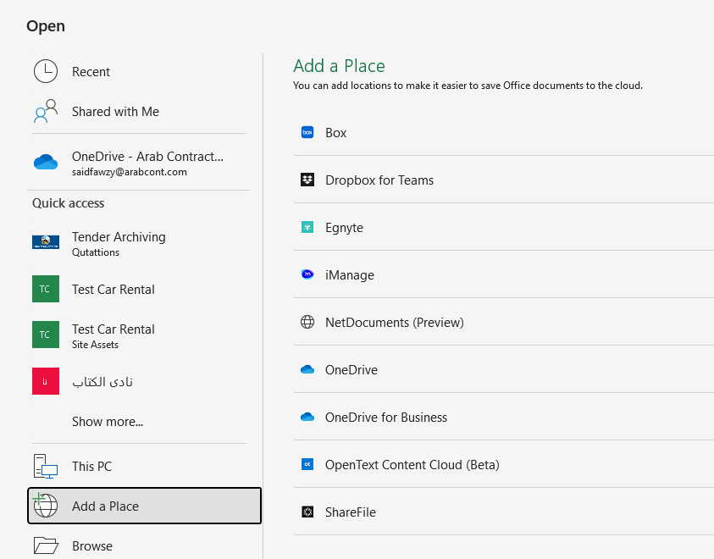
Understanding the Excel Start Screen
Open Page

Slide 27
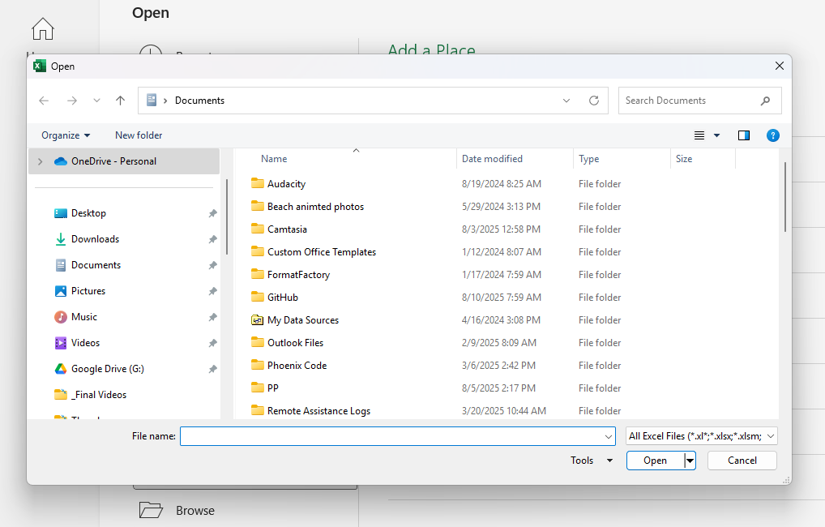
Understanding the Excel Start Screen
Open Page

Slide 28
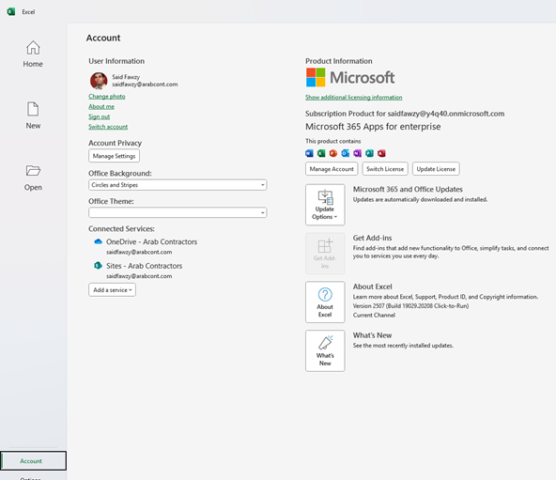
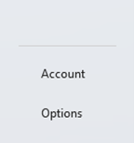
Understanding the Excel Start Screen
Account

Slide 29
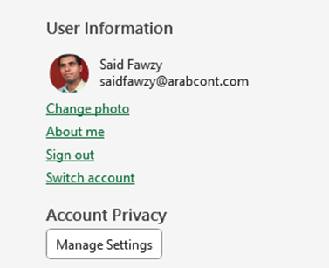
Understanding the Excel Start Screen
Account

Slide 30
Understanding the Excel Start Screen
Account

Slide 31
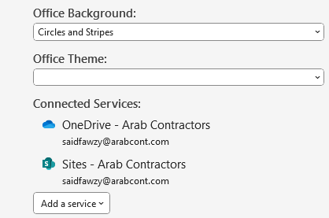
Understanding the Excel Start Screen
Account

Slide 32
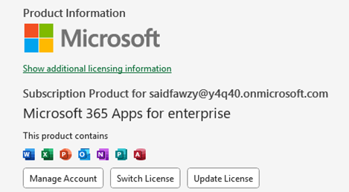
Understanding the Excel Start Screen
Account

Slide 33
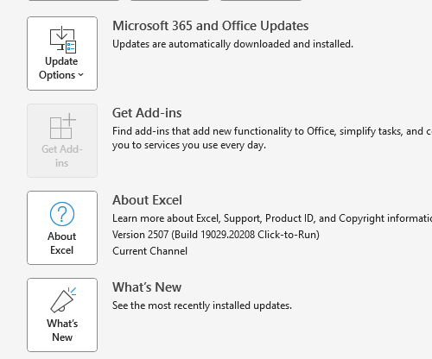
Understanding the Excel Start Screen
Account

Slide 34
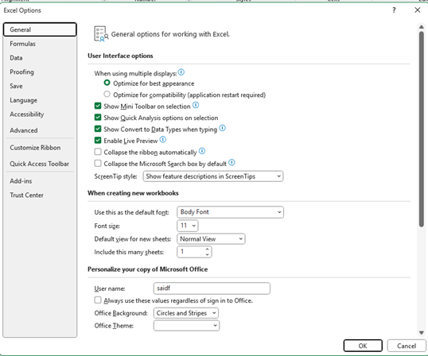
Understanding the Excel Start Screen
Options

Slide 35
Excel
Training
for Beginners
SAID FAWZY
Navigating the Excel Interface
3

Slide 36
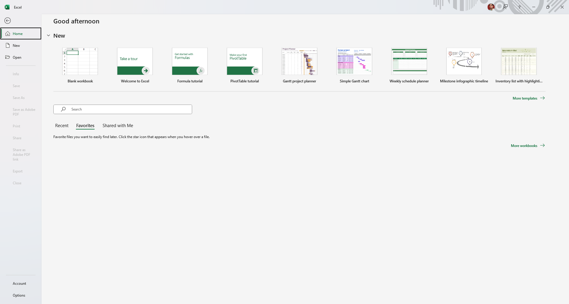
Understanding the Excel Start Screen
Backstage

Slide 37
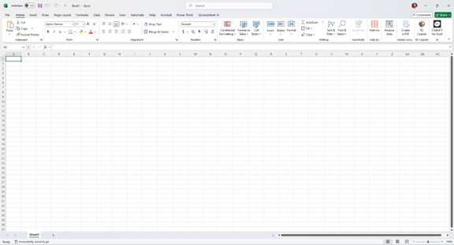
Navigating the Excel Interface
Blank Workbook

Slide 38

Navigating the Excel Interface
Title Bar

Slide 39

Navigating the Excel Interface
Title Bar

Slide 40
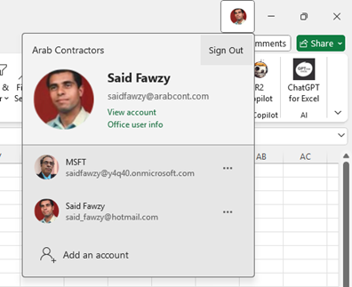
Navigating the Excel Interface
Title Bar

Slide 41
Navigating the Excel Interface
Title Bar

Slide 42

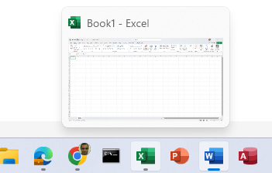
Navigating the Excel Interface
Title Bar

Slide 43
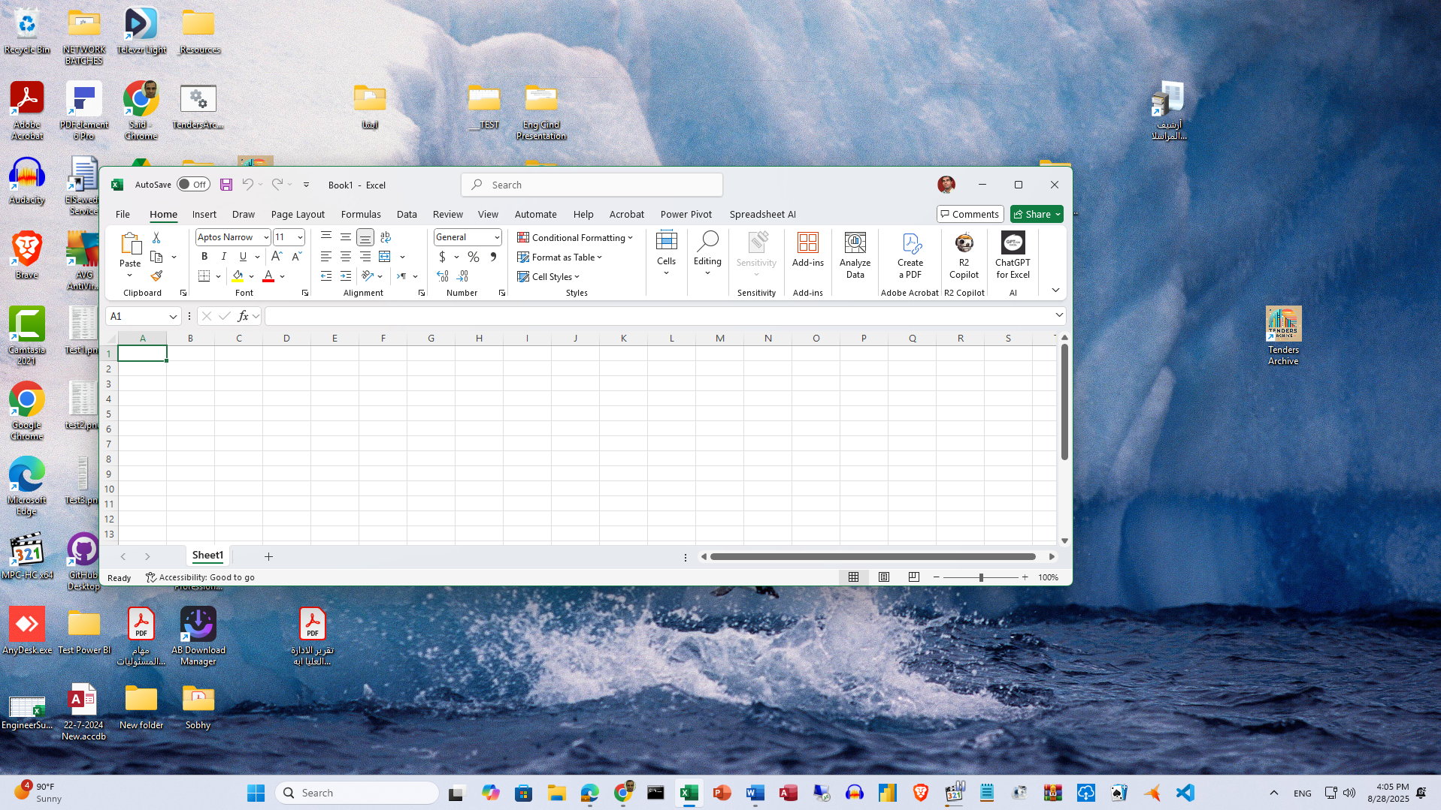
Navigating the Excel Interface
Title Bar

Slide 44
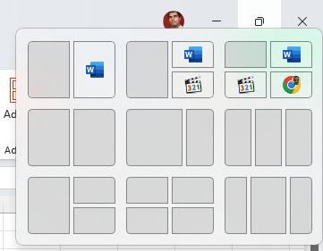
Navigating the Excel Interface
Title Bar

Slide 45

Navigating the Excel Interface
Title Bar

Slide 46

Navigating the Excel Interface
Tabs and Ribbons

Slide 47
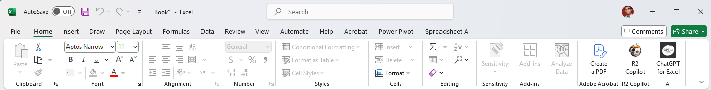
Navigating the Excel Interface
Tabs and Ribbons

Slide 48
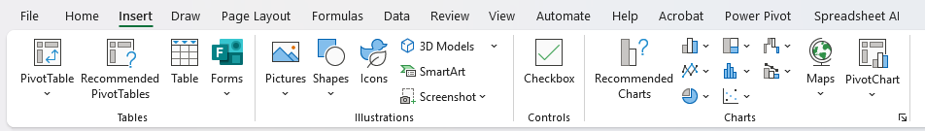
Navigating the Excel Interface
Tabs and Ribbons

Slide 49
Navigating the Excel Interface
Tabs and Ribbons

Slide 50
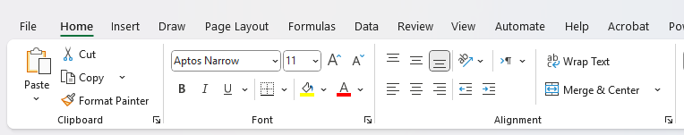
Navigating the Excel Interface
Tabs and Ribbons

Slide 51
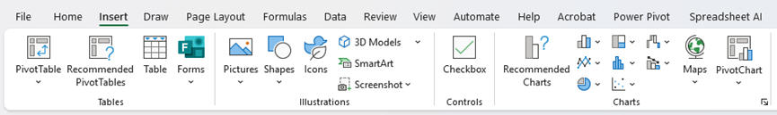
Navigating the Excel Interface
Tabs and Ribbons

Slide 52
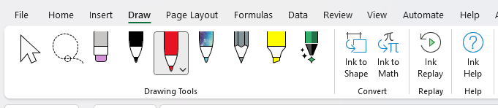
Navigating the Excel Interface
Tabs and Ribbons

Slide 53

Navigating the Excel Interface
Tabs and Ribbons

Slide 54
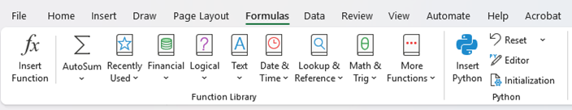
Navigating the Excel Interface
Tabs and Ribbons

Slide 55

Navigating the Excel Interface
Tabs and Ribbons

Slide 56

Navigating the Excel Interface
Tabs and Ribbons

Slide 57
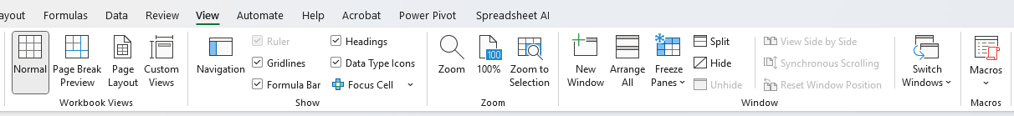
Navigating the Excel Interface
Tabs and Ribbons

Slide 58
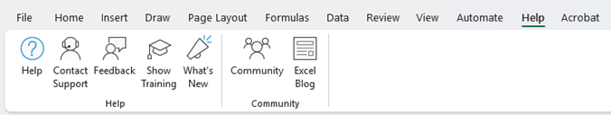
Navigating the Excel Interface
Tabs and Ribbons

Slide 59
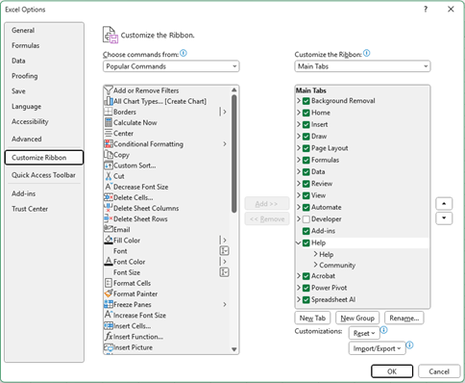
Navigating the Excel Interface
Turn on and Off Ribbon Tabs

Slide 60

Navigating the Excel Interface
Name Box – Formula Bar

Slide 61
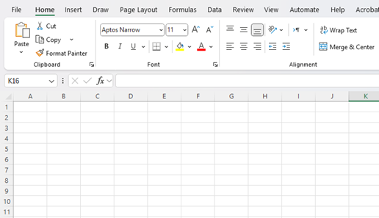
Navigating the Excel Interface
The Worksheet

Slide 62
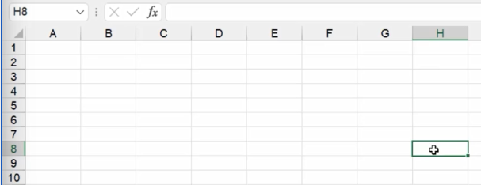
Navigating the Excel Interface
Cell Reference

Slide 63

Navigating the Excel Interface
Sheet Tabs

Slide 64
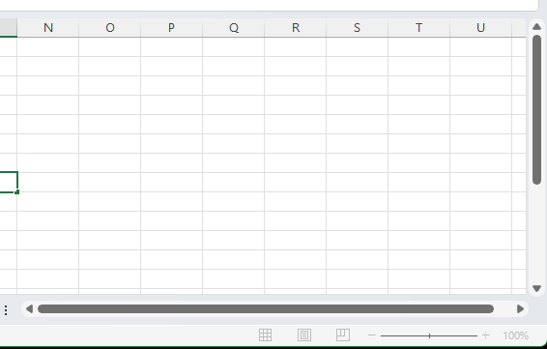
Navigating the Excel Interface
Scroll Bars

Slide 65

Navigating the Excel Interface
Status Bar

Slide 66
Navigating the Excel Interface
Status Bar

Slide 67
Excel
Training
for Beginners
SAID FAWZY
Working with Ribbons, Tabs, and Menus
4

Slide 68
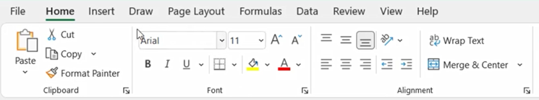
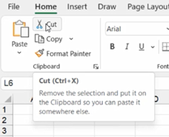
Working with Ribbons, Tabs, and Menus
Tabs and Ribbons

Slide 69
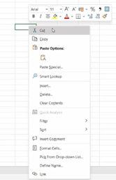

Working with Ribbons, Tabs, and Menus
Contextual Menu

Slide 70

Working with Ribbons, Tabs, and Menus
Mini Toolbar

Slide 71

Working with Ribbons, Tabs, and Menus
Mini Toolbar

Slide 72


Working with Ribbons, Tabs, and Menus
Diagonal Down Arrow

Slide 73

Working with Ribbons, Tabs, and Menus
Clipboard Pane

Slide 74


Working with Ribbons, Tabs, and Menus
Hiding and Showing Ribbon

Slide 75
Excel
Training
for Beginners
SAID FAWZY
Exploring the Backstage View
5

Slide 76

Exploring the Backstage View
Backstage Area

Slide 77



Exploring the Backstage View
Info Page

Slide 78
Excel
Training
for Beginners
SAID FAWZY
Customizing the Quick Access Toolbar (QAT)
6

Slide 79


Customizing the Quick Access Toolbar (QAT)
QAT

Slide 80

Customizing the Quick Access Toolbar (QAT)
QAT

Slide 81

Customizing the Quick Access Toolbar (QAT)
QAT

Slide 82


Customizing the Quick Access Toolbar (QAT)
Turn On and Off QAT

Slide 83

Customizing the Quick Access Toolbar (QAT)
Adding More Commands to QAT from Ribbon

Slide 84
Customizing the Quick Access Toolbar (QAT)
Adding Commands to QAT not included in the Ribbon

Slide 85

Customizing the Quick Access Toolbar (QAT)
Adding Commands to QAT not included in the Ribbon

Slide 86


Customizing the Quick Access Toolbar (QAT)
Adding Commands to QAT not included in the Ribbon

Slide 87

Customizing the Quick Access Toolbar (QAT)
Remove Command

Slide 88
Excel
Training
for Beginners
SAID FAWZY
Mastering Useful Keyboard Shortcuts
7

Slide 89



Mastering Useful Keyboard Shortcuts
Shortcuts

Slide 90




Mastering Useful Keyboard Shortcuts
Shortcuts

Slide 91


Mastering Useful Keyboard Shortcuts
Shortcuts

Slide 92


Mastering Useful Keyboard Shortcuts
Shortcuts

Slide 93

Mastering Useful Keyboard Shortcuts
Shortcuts

Slide 94

Mastering Useful Keyboard Shortcuts
Shortcuts

Slide 95

Mastering Useful Keyboard Shortcuts
Shortcuts

Slide 96
Excel
Training
for Beginners
SAID FAWZY
Finding and Using Excel Help
8

Slide 97

Finding and Using Excel Help
Screen Tips

Slide 98


Finding and Using Excel Help
Screen Tips

Slide 99

Finding and Using Excel Help
Help Menu

Slide 100


Finding and Using Excel Help
Contact support

Slide 101

Finding and Using Excel Help
Feedback

Slide 102

Finding and Using Excel Help
Show Training

Slide 103

Finding and Using Excel Help
What’s New

Slide 104

Finding and Using Excel Help
Community

Slide 105

Finding and Using Excel Help
Blog

Slide 106

Finding and Using Excel Help
Search Bar

Slide 107


Finding and Using Excel Help
Contextual Help

Slide 108
Excel
Training
for Beginners
SAID FAWZY
Exam 1
Working with Excel

Slide 109

Exam 1: Working with Excel
Contextual Help

Slide 110



